Slide 1
AUDIT USING TALLY FEATURES
DATE : 17.02.2024
PRESENTED BY: Rohan Andley & Divvya Bhatia
MENTORED BY: Shikhar Tewari

Slide 2
Topics to be discussed
Sampling, Relative Size Factor (RSF)
Analytical Procedures
Inventory Reports
Import of Bank Statement and BRS Function
Saved View Report
Verification of Opening balances
Edit Log Transaction
Uncertain transactions in GSTR Reports
Remote Access
New Features in Tally Prime 4.0
Tally ERP Vs Tally Prime 4.0
Financial Reports in Tally Prime
vkalra.com

Slide 3
Tally Features
Inventory integration
Group Company
Audit Trail
Statutory Compliances
Payroll Processing
Data Security
Analysis and Verification Report
vkalra.com

Slide 4
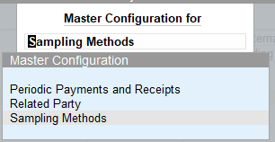
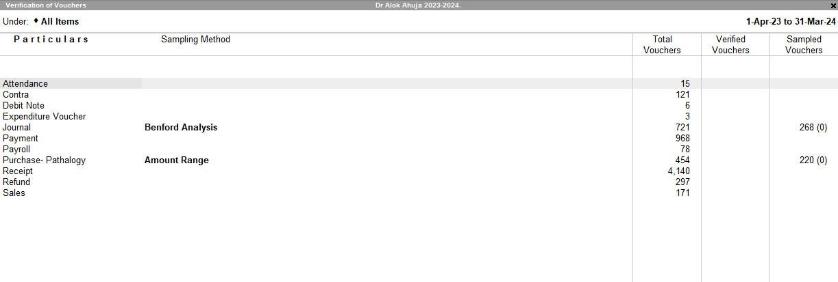
Sampling Methods
Go to Display More Reports
Select
Alt + V
Select Sampling Methods and Accept
Voucher Verification
Select
Alt + V
Select Sampling Methods and Accept
Analysis & Verification
Verification of Vouchers
vkalra.com

Slide 5
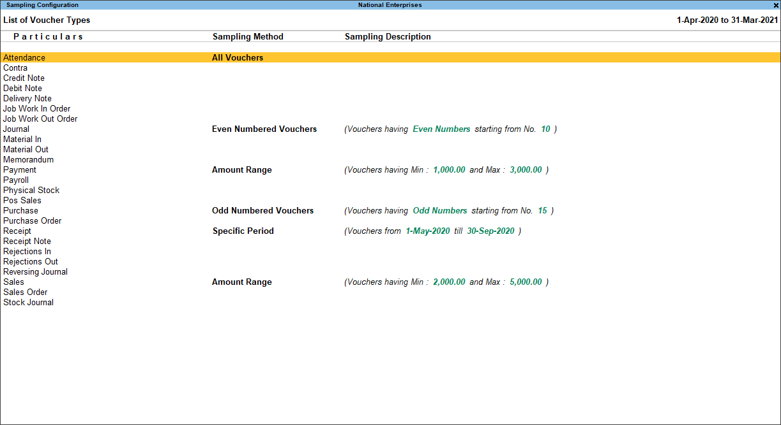
Sampling Methods
vkalra.com

Slide 6
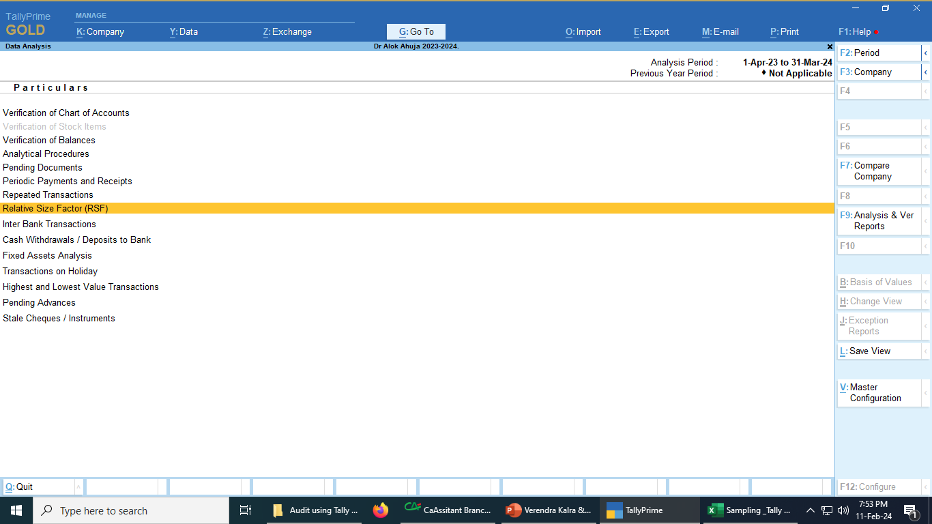
Relative Size Factor (RSF)
Compare the Highest Value transactions for each Ledger Vouchers to the Second Highest Value and displays the Relative Size Factor which can lead into further investigation to correct the above mistakes.
Go to Display More Reports
Analysis & Verification
Data Analysis
vkalra.com

Slide 7
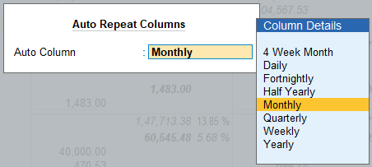
Analytical Procedures
We can analyze the Trend by converting to monthly, Quarterly, Half Yearly
Go to Profit & Loss A/c
Click F12 to select Show Percentages
Press Alt + N
vkalra.com

Slide 8
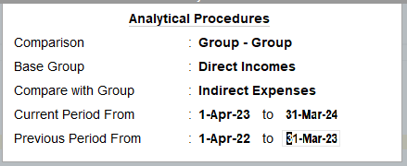
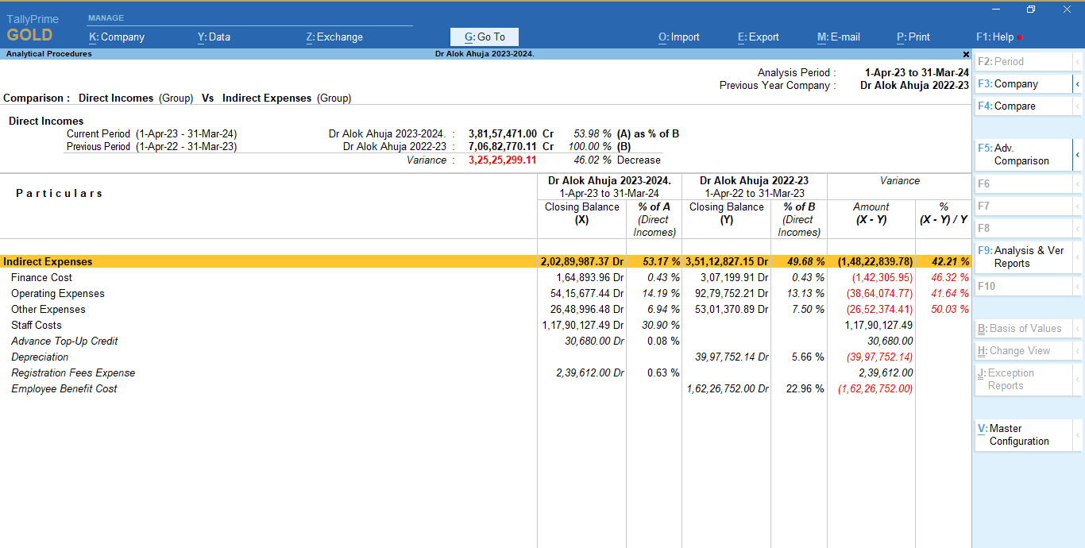
Analytical Procedures
Go to Analytical Procedures
Then select the comparison of data based on base group as compared to other group
Select Comparison category
vkalra.com

Slide 9
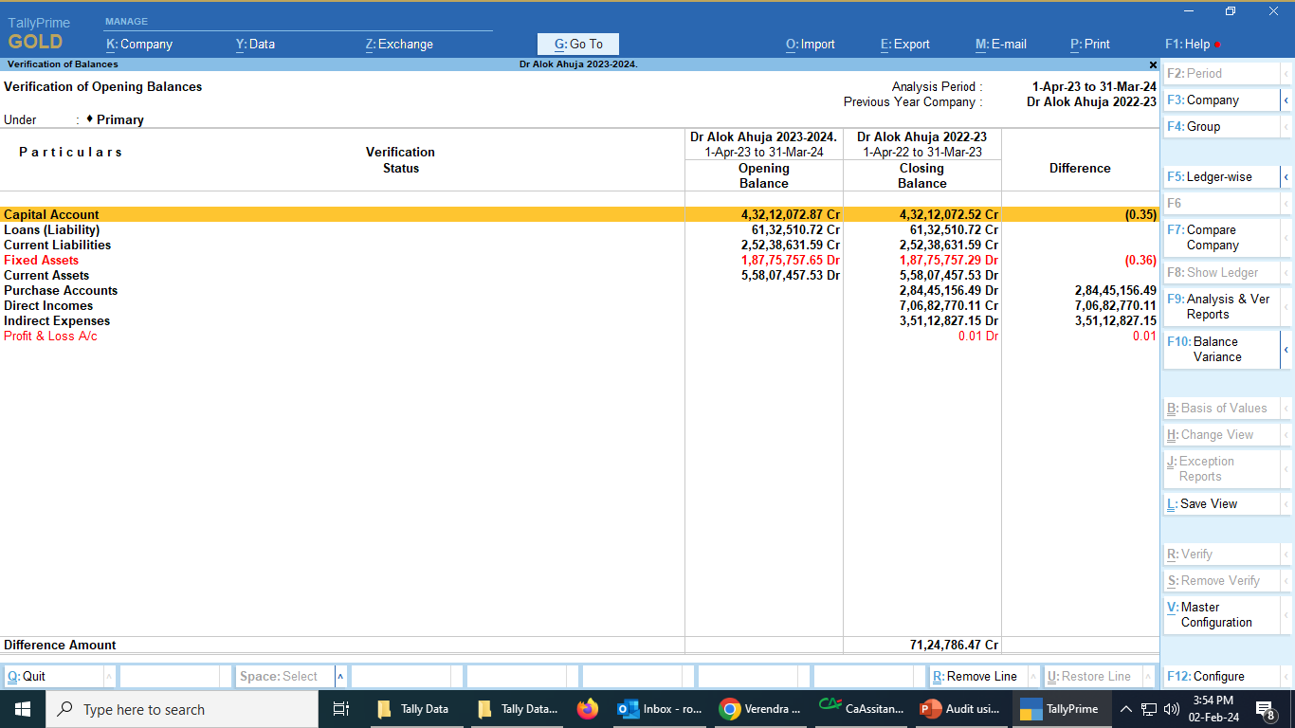
Analytical Procedures
vkalra.com

Slide 10
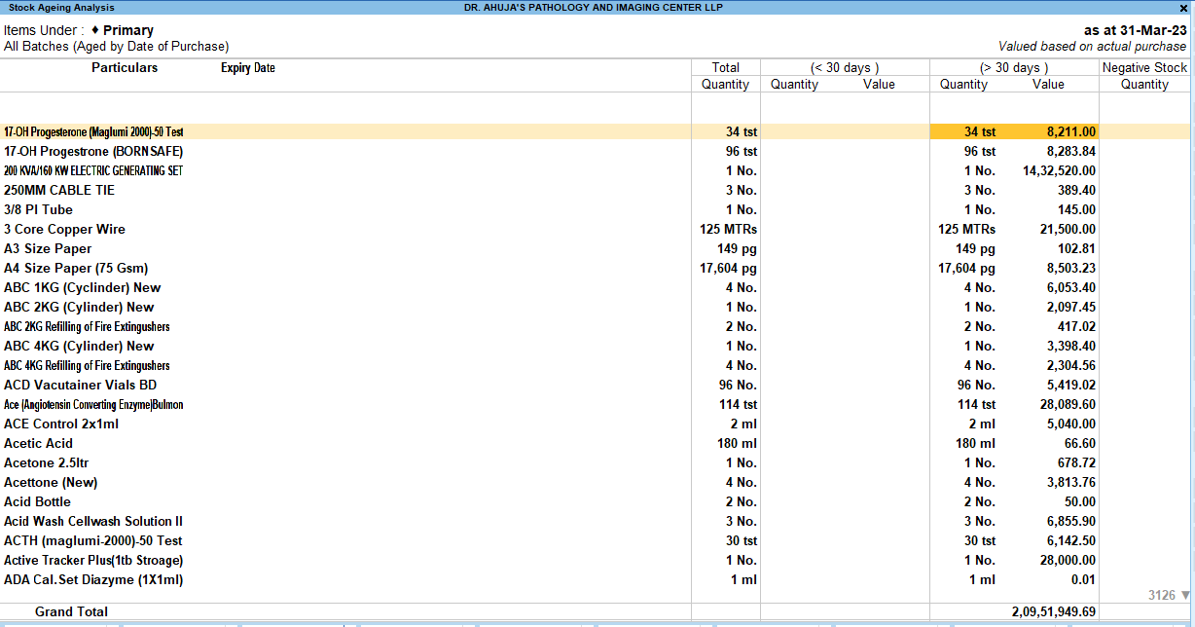
Inventory Reports
Press Alt+G (Go To) > type or select Ageing Analysis > and press Enter.
Alternatively, Gateway of Tally > Display More Reports > Statement of Inventory > Ageing Analysis.
Select the Group and stock item for which Ageing Analysis is required.
The Inwards, Outwards movement and the Closing Balance of the selected item is displayed in the report.
vkalra.com

Slide 11
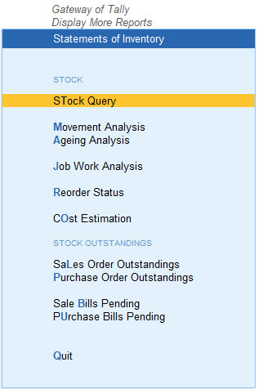
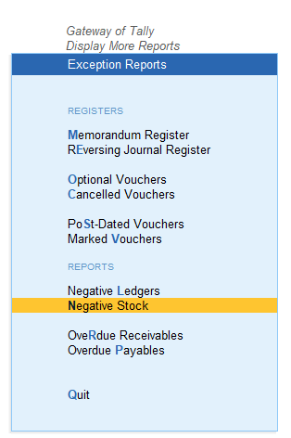
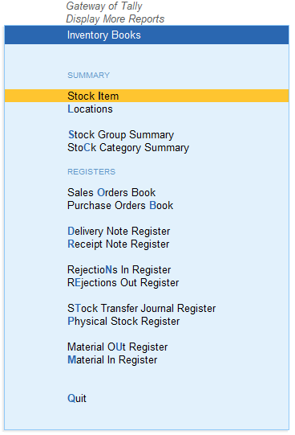
Inventory Reports
vkalra.com

Slide 12
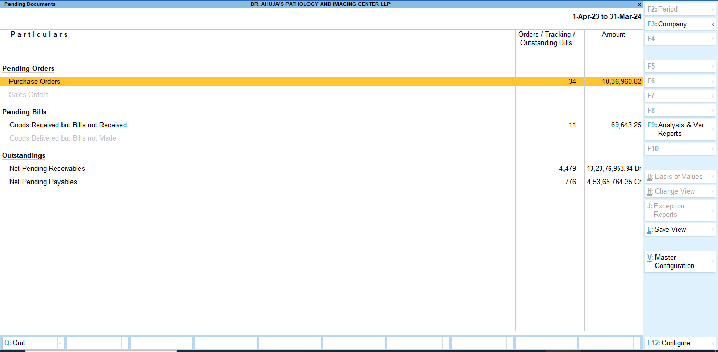
Inventory Reports
vkalra.com

Slide 13
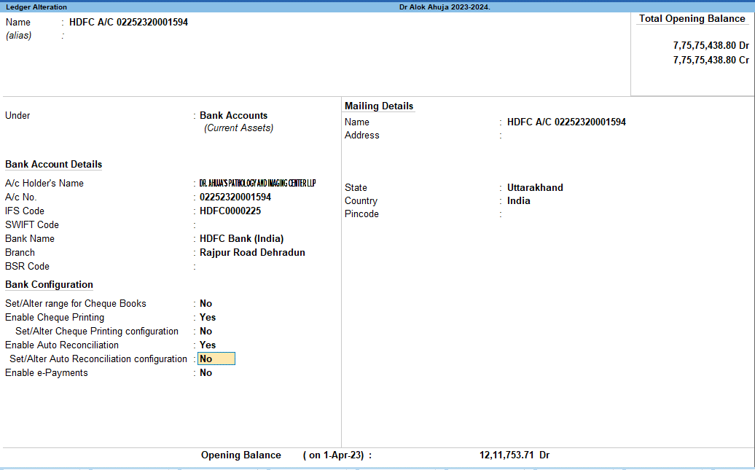
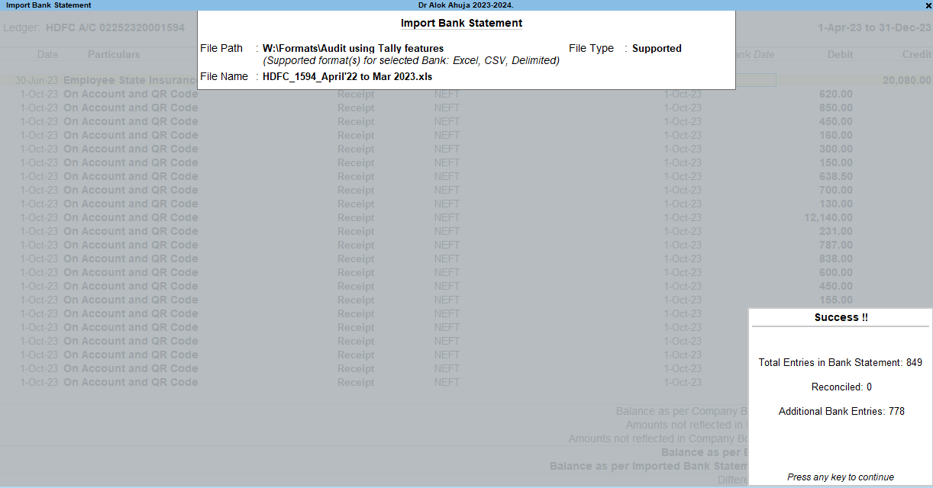
Import of Bank Statement and BRS Function
.
vkalra.com

Slide 14
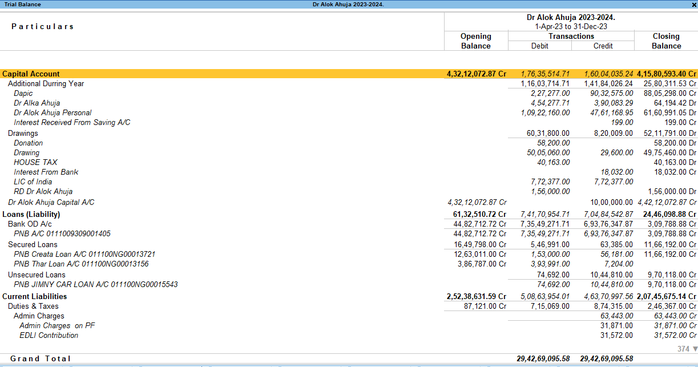
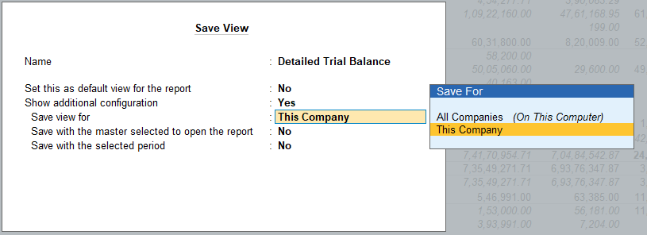
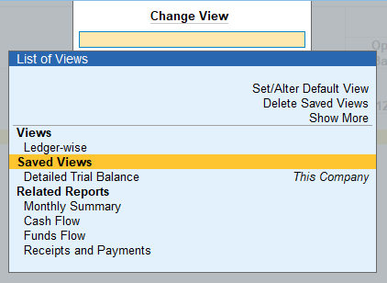
Saved View Report
It is used to save the detailed trial balance- View. We do not have to select command for opening balance & expanded format.
Click on Save view- Ctrl-L
Click on Change View (Ctrl+H) and select the saved views.
Fill up the name as required
Select additional configuration
Click on Save view for
vkalra.com
Notes:
Dynamic Reports can be generated and same can be done for other reports like cash transaction above 10,000/-

Slide 15
Verification of Opening Balances
Go to Display
Verification of Balances : This is the trial balance of the current company.
Click on Compare Company(F7) Company Data for comparison
In case of different tally version, it has to be migrated to current version.
Compare Company
More Reports
Analysis & Verification
Data Analysis
vkalra.com

Slide 16
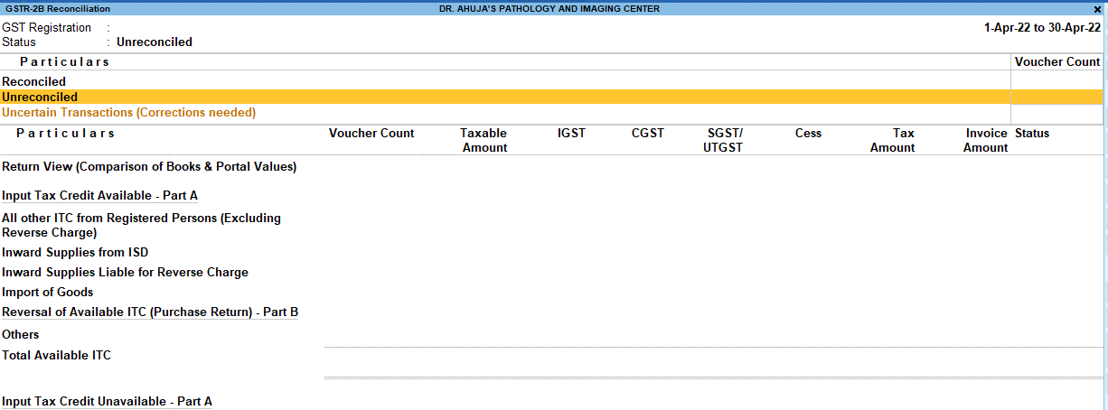
Uncertain transactions (Corrections required)
in GSTR Reports
vkalra.com

Slide 17
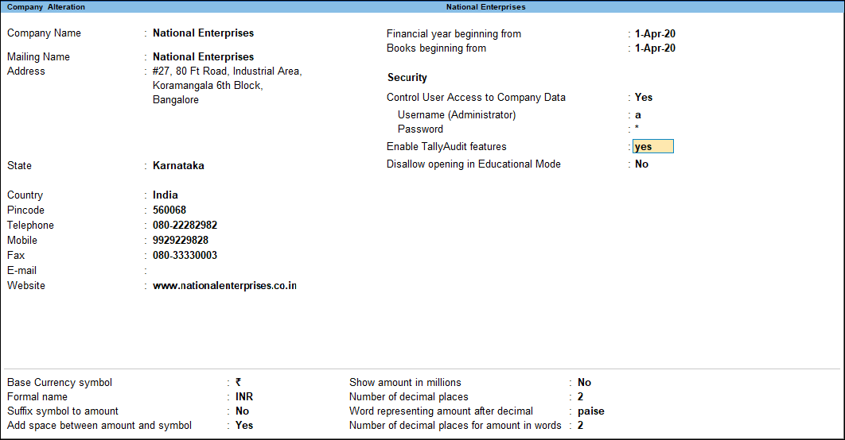
The MCA has amended the proviso vide Companies (Accounts) Second Amendment Rules, 2022 and has deferred the applicability by another year. Hence the provision of audit trail is now applicable w.e.f. April 01, 2023. The latest release 'Tally Prime Edit Log Release 4', is enhanced with the edit log feature that caters to the amendment released by the Ministry of Corporate Affairs (MCA).
Audit Trail Function
Go to Alt+K
Enable Audit Tally Features
Press Migrate
vkalra.com

Slide 18
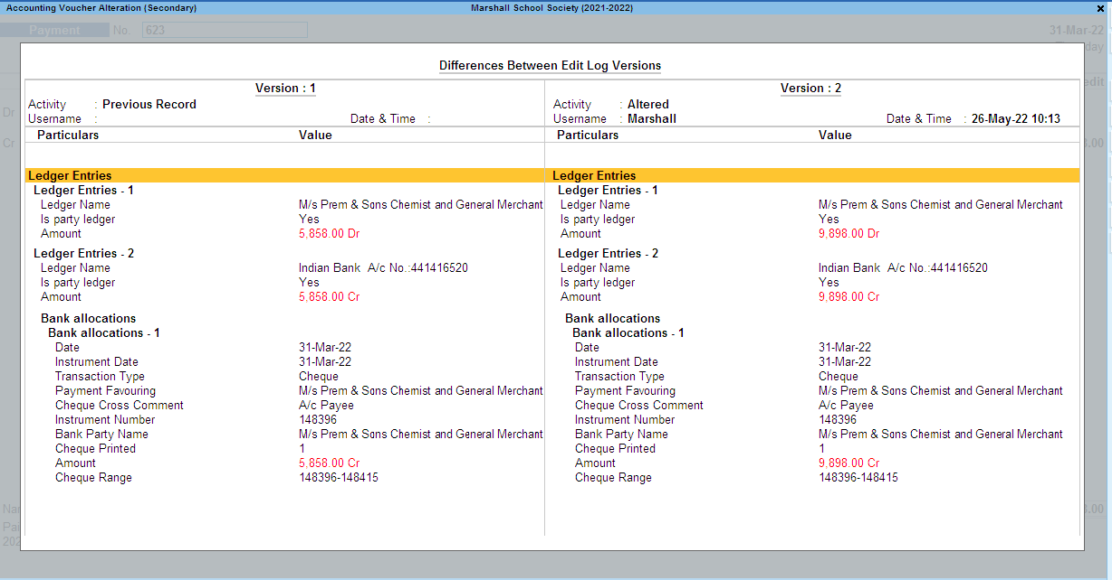
Audit Trail Function
.
Sample format of Report Generated by Tally Prime applying previous slide function
vkalra.com

Slide 19
Comprehensive Audit Documentation
A well-planned audit programme
Collection of evidence
Audit documentation features consisting of audit programme, working papers, checklists for standards assist of evidence to support audit observations and findings.
Go to Gateway of Tally > Display More Reports> Statement of Accounts > Tally Audit > Voucher Types.
BENEFITS
FEATURES
HOW TO
vkalra.com

Slide 20
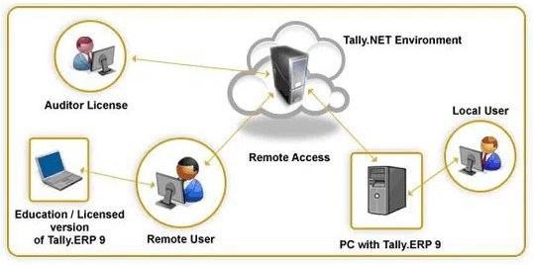
For Security Access : Go to Alt+K to Alter, Select Yes and enter Username and Password User Roles : Select Tally.NET User enter use basic features of then allow company to connect User and Passwords : Click Yes on Allow Remote Access and save Features : Click Yes on Online Access function Enable Tally.NET Services for Remote Access & Synchronization Click Connect (C) From Client System Select Remote Company (F1) Login in Credentials for Tally. NET User Shown as company in Online login section
Remote Access – Tally Prime
.
vkalra.com

Slide 21
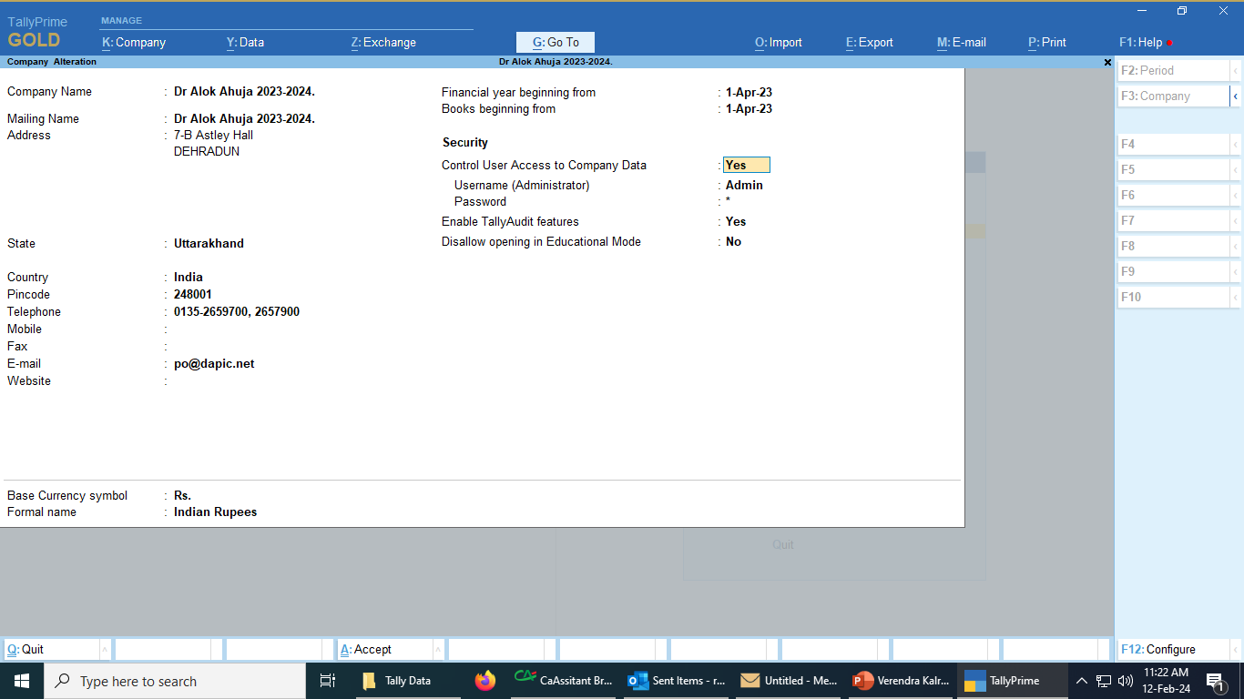
Remote Access – Tally Prime
.
vkalra.com

Slide 22
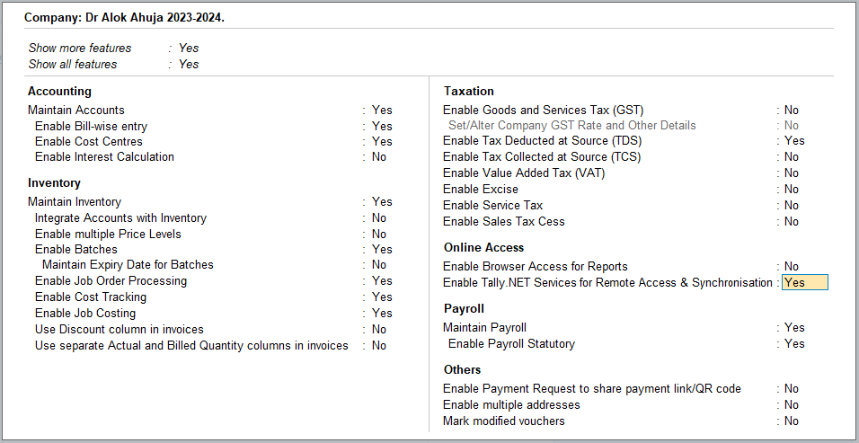
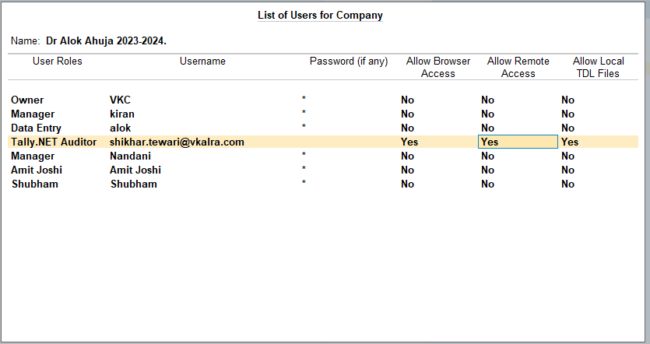
Remote Access – Tally Prime
.
vkalra.com

Slide 23
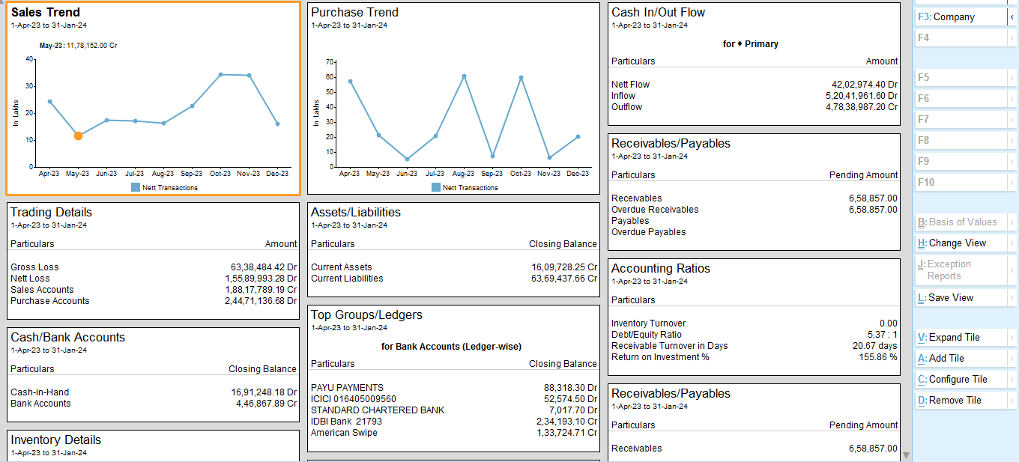
Graphical Dashboard in Tally prime 4.0
.
vkalra.com

Slide 24
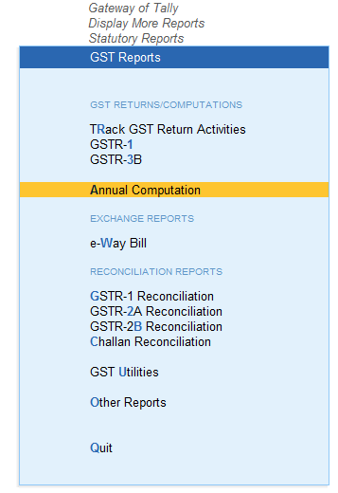
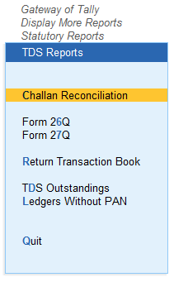
Statutory Reports in Tally prime 4.0
Go to Statutory Reports
The desired reports can be generated provided the information is feed in the appropriate way.
.
vkalra.com

Slide 25
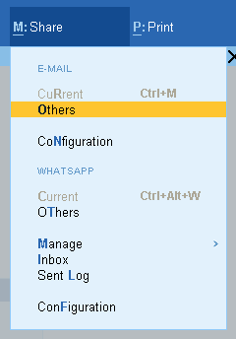
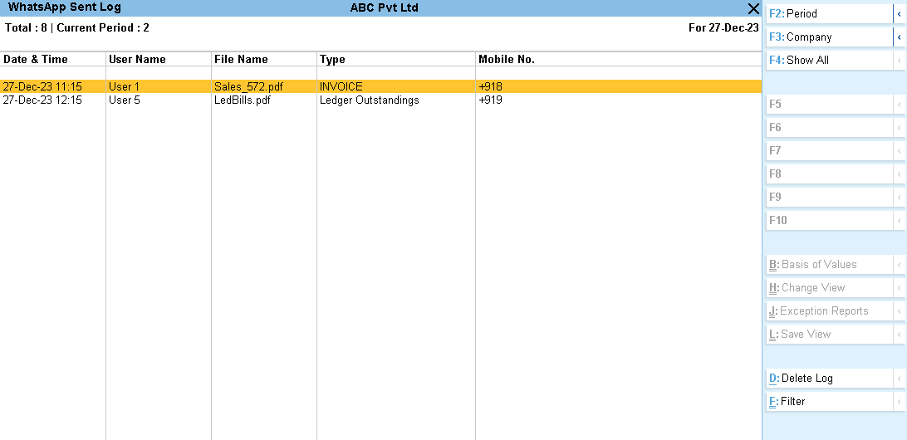
WhatsApp Sent Log within Tally Prime 4.0
.
To enable add-on, navigate to Gateway of Tally → Help (F1) →TDL & Add-Ons → Add - On Features (F6) & Set ‘Activate WhatsApp Sent Log within Tally’ to ‘Yes’.
vkalra.com

Slide 26
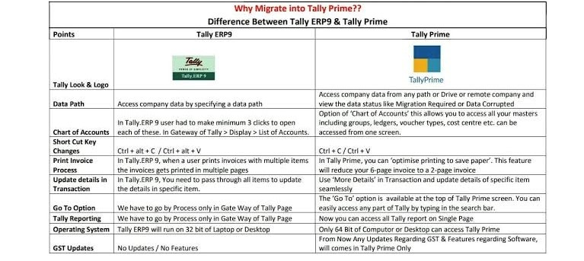
Comparison between Tally ERP 9 and Tally Prime 4.0
.
vkalra.com

Slide 27
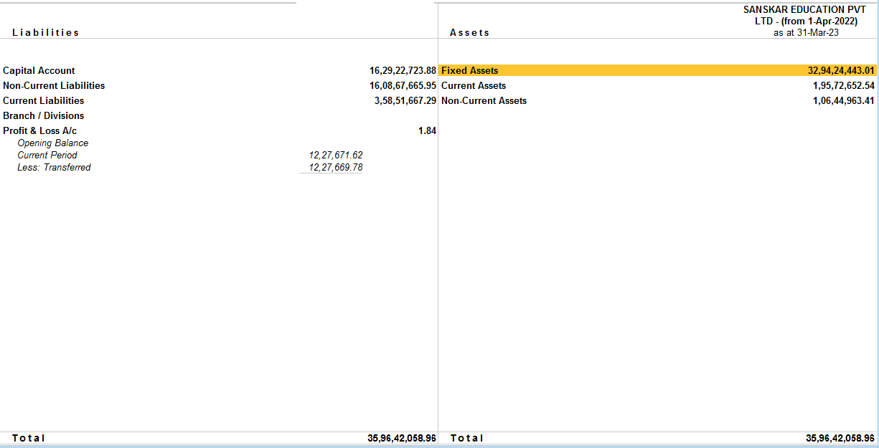
Financial Reports in Tally Prime
Balance Sheet
.
vkalra.com

Slide 28
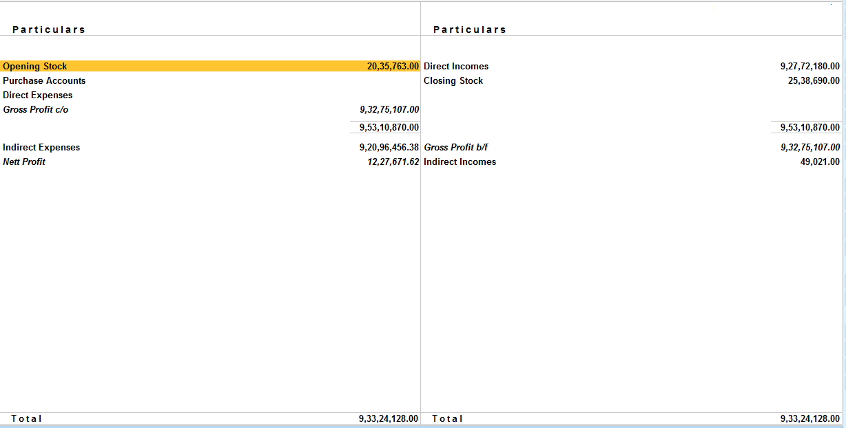
Financial Reports in Tally Prime
Profit and Loss Account
.
vkalra.com

Slide 29
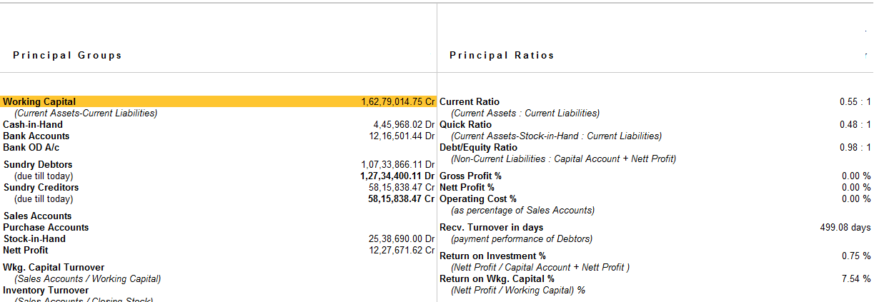
Financial Reports in Tally Prime
Ratio Analysis
.
vkalra.com

Slide 30
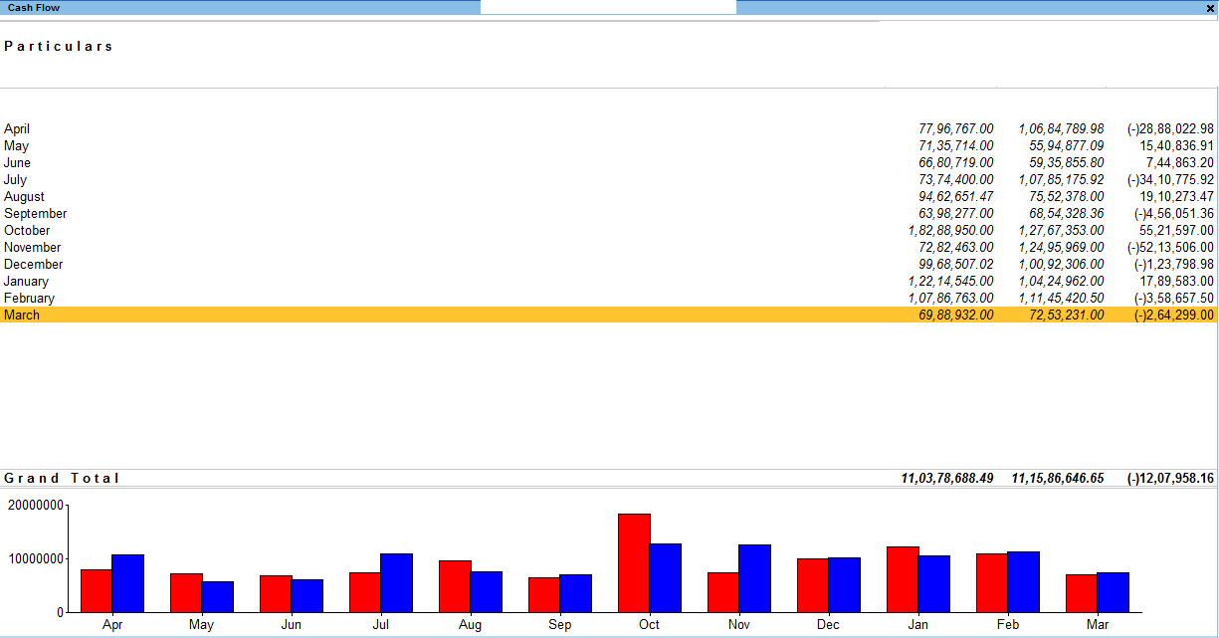
Financial Reports in Tally Prime
Cashflows
.
vkalra.com

Slide 31
A. Enhancing collaboration and communication within audit teams. B. Streamlining the process of generating financial reports. C. Providing access to real time data analytics. D. Automating the entire audit process.
Ques 1) What is one way in which Tally’s intellectual tools and techniques empower audit professionals ?
.
vkalra.com

Slide 32
A. Tally’s tools are primarily focused on financial reporting and analysis. B. Tally’s tools are designed exclusively for small businesses and cannot be used by large corporations. C. Tally’s tools are limited to bookkeeping functions and do not support advanced audit processes. D. Tally’s tools provide comprehensive features for data reconciliation, audit trail analysis and compliance reporting.
Ques 2) Which of the following is a correct statement about Tally’s intellectual tools and techniques for empowering audit professionals ?
.
vkalra.com

Slide 33
A. By automating repetitive tasks and reducing manual errors. B. By providing real-time financial insights and analysis. C. By offering customizable reporting and visualizing options. D. By streamlining collaboration and communication among team members.
Ques 3) How do Tally’s intellectual tools and techniques empower audit professional ?
.
vkalra.com

Slide 34
A. Will be more efficient at producing financial statements. B. Eliminates the need to reconcile control accounts and subsidiary ledgers. C. Does not require as stringent a set of internal controls. D. Will produce a more accurate set of financial statements.
Ques 4) What is the advantage of a computer based transaction processing system ?
.
vkalra.com

Slide 35
A. Gateway of Tally > Display B. Gateway of Tally > Display > Statement of Accounts C. Gateway of Tally > Display > Statement of Payroll D. Gateway of Tally > Display > Payroll Reports
Ques 5) To get Payroll Reports choose
.
vkalra.com

Slide 36
A. Depends on number of companies B. One company to another company created with in Tally package C. Other programs – A spreadsheet or database file D. Both 2 and 3
Ques 6) How can data be imported in tally
.
vkalra.com

Slide 37
Thank You
3rd Floor, MJ Tower,
55, Rajpur Road,
Dehradun - 248001
T: +91.135.2743283
+91.135.2747084
W: vkalra.com
Follow us on

